Slide 1
Inhibitor development according to FVIII concentrate in PUPs: how to interpret current evidence?
Alfonso Iorio
Health Information Research Unit & Hamilton-Niagara Hemophilia Program
McMaster University

Slide 2
Disclosures for Alfonso Iorio
In compliance with COI policy, EAHAD requires the following disclosures to the session audience:
Shareholder | No relevant conflicts of interest to declare
Grant / Research Support | Bayer, Baxter, Biogen Idec, Novo Nordisk, Pfizer
Consultant | Bayer, Baxter, Novo Nordisk
Employee | No relevant conflicts of interest to declare
Paid Instructor | No relevant conflicts of interest to declare
Speaker bureau | No relevant conflicts of interest to declare
Honoraria | Bayer, Baxter, CSL, Octapharma, Pfizer
Presentation includes discussion of the following off-label use of a drug or medical device: <N/A>

Slide 3
Overview
Assessing causality: methodological notes
Appraising data on the concentrate dependent risk of inhibitors
Implications and perspectives
Notes:
Will introduce starting from 2, then 1 and 3

Slide 4
Overview
Assessing causality: methodological notes
Appraising data on the concentrate dependent risk of inhibitors
Implications and perspectives
Notes:
Will introduce starting from 2, then 1 and 3

Slide 5
ADVATE
KOGENATE
TREATMENT
0 ED 50
KOGENATE
ADVATE

Slide 6
RANDOM
ADVATE
KOGENATE
TREATMENT
NEXT PATIENT
Large deletion
Deletion + history
Point + history
Point mutation
Point mutation
Family history
Family history
Point mutation
Family history
Point + history
Deletion + history
MULTIVARIABLE
ANALYSIS

Slide 7
MULTIVARIABLE
ANALYSIS
Brand
Gene mutation
Family history

Slide 8
MULTIVARIABLE
ANALYSIS
Brand
Gene mutation
Family history
?
??Unknown
??

Slide 9
MULTIVARIABLE
ANALYSIS
Brand
Gene mutation
Kogenate/Advate
Family history
?
??Unknown
??

Slide 10
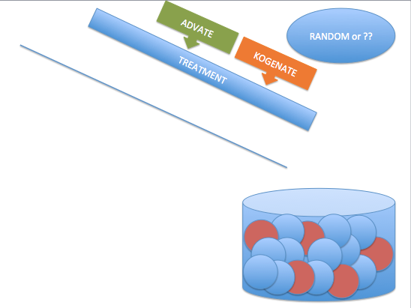

Slide 11
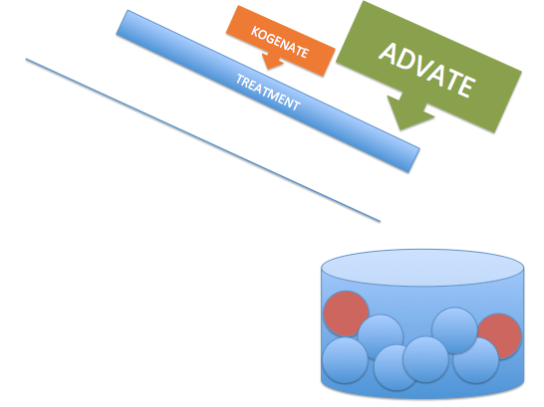
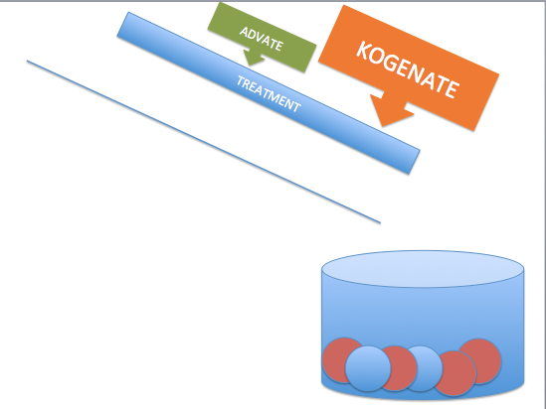
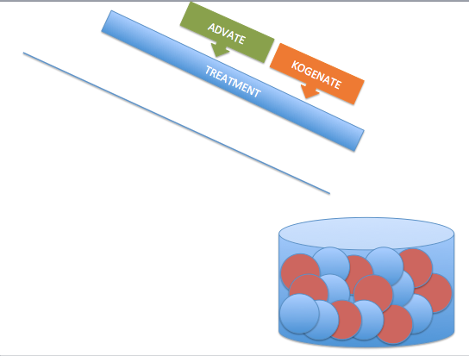
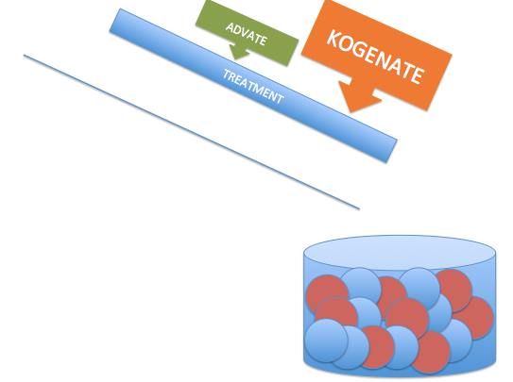

Slide 12
Assessing causality – summary notes Selection by indication
Selection by indication
Unbalanced risk of event at baseline
Center effect
The effect of center is a proxy for what you cannot measure
it is constantly checked even in randomized trials
Methods exists for small centers
Center effect and “center size” effect ARE NOT the same
McGilchrist, CA et al. Regression with frailty in survival analysis. Biometrics, 1991 47, 461-6.
Hougaard, P. Frailty models for survival data. Lifetime Data Analysis, 1995, 1, 255-273.

Slide 13
Overview
Assessing causality: methodological notes
Appraising data on the concentrate dependent risk of inhibitors
Implications and perspectives
Notes:
Will introduce starting from 2, then 1 and 3

Slide 14
Concentrate based risk of inhibitors
RODIN
France Coag
UK UKHCDO
Vazina
EUHASS
EAHAD Metanalysis
For each one:
Design
Main result
Key to appraisal
Does it point to a true difference of K vs A as the most likely explanation?

Slide 15
Evidence profiling
Study | Design | Main result | interpretation | Contribution
RODIN
UKHCDO
France C
Vezina
EUHASS
EAHAD IPD
Notes:
RODIN: you comment on the different objective of the study upfront; the non inclusion of the significant variable in the blood analysis

Slide 16
Evidence profiling
Study | Design | Main result | interpretation | Contribution
RODIN | P, R, IC, MC | Year: 2000-2010 Tot: 340 (574) RC, RD: 28.2, 9.0% | Post hoc Multivariable (+) | Hypothesis generation
UKHCDO
France C
Vezina
EUHASS
EAHAD IPD
P = prospective; R = retrospective; IC – Inception cohort; MC = Multisite
Notes:
RODIN: you comment on the different objective of the study upfront; the non inclusion of the significant variable in the blood analysis
Advate: 42/172 24.4
Kogenate: 45/128 35.2
Refacto: 15/44 34%
RODIN (33/88 (37.5%) vs 85/319 (26.7%), P=0.05.
Advate nR 29/114
Advate R 13/48
Kogenate nR 35/107
Kogenate R 10/21
There was a trend for the incidence of low titre inhibitors to increase and for high titre inhibitors to decrease with time. Between 2000 and 2006, there were 25 low titre inhibitors in 205 PUPs (12.2%) compared with 33/202 (16.3%) during 2007-2013 (P=0.23). In 2000-2006 there were 37/205 high titre inhibitors (18.1%) compared with 23/202 (11.4%) in 2007-2013, (P=0.06).

Slide 17
Evidence profiling
Study | Design | Main result | interpretation | Contribution
RODIN | P, R, MC | Year: 2000-2010 Tot: 340 (574) RC, RD: 28.2, 9.0% | Post hoc Multivariable (+) | Hypothesis generation
UKHCDO | R, IC, SC | Year: 2000-2010 Tot: 300 (407) RC, RD: 23.8, 11.3% | Time effect, B-DD f-VIII, RODIN effect | Generate alternative hypothesis
France C
Vezina
EUHASS
EAHAD IPD
P = prospective; R = retrospective; IC – Inception cohort; MC = Multisite, SC = single country
Notes:
RODIN: you comment on the different objective of the study upfront; the non inclusion of the significant variable in the blood analysis
Advate: 42/172 24.4
Kogenate: 45/128 35.2
Refacto: 15/44 34%
RODIN (33/88 (37.5%) vs 85/319 (26.7%), P=0.05.
Advate nR 29/114
Advate R 13/48
Kogenate nR 35/107
Kogenate R 10/21
There was a trend for the incidence of low titre inhibitors to increase and for high titre inhibitors to decrease with time. Between 2000 and 2006, there were 25 low titre inhibitors in 205 PUPs (12.2%) compared with 33/202 (16.3%) during 2007-2013 (P=0.23). In 2000-2006 there were 37/205 high titre inhibitors (18.1%) compared with 23/202 (11.4%) in 2007-2013, (P=0.06).

Slide 18
UKHCDO cohort: effect of time and … RODIN?
Kogenate
Advate
Dashed line =
RODIN centers
Advate 3/12 | 26/117 | 13/43
Kogenate 24/65 | 16/31 | 5/32
Notes:
Also comment that many patients when to Refacto, and got inhbitors

Slide 19
Evidence profiling
Study | Design | Main result | interpretation | Contribution
RODIN | P, R, IC, MC | Year: 2000-2010 Tot: 340 (574) RC, RD: 28.2, 9.0% | Post hoc Multivariable (+) | Hypothesis generation
UKHCDO | R, IC, SC | Year: 2000-2010 Tot: 300 (407) RC, RD: 23.8, 11.3% | Time effect, Refacto, RODIN effect | Generate alternative hypothesis
France Coag | R, IC, SC | Year: 2000-2010 Tot: 234 (303) RC, RD: 30.0, 15.0% | “center” effect Multivariable (-) RODIN effect ?? | Generate a second alternative hypothesis
Vezina
EUHASS
EAHAD IPD
P = prospective; R = registry; MC = multiple centers/countries, IC = inception cohort, SC = single country
Notes:
RODIN: you comment on the different objective of the study upfront; the non inclusion of the significant variable in the blood analysis
Advate: 42/172 24.4
Kogenate: 45/128 35.2
Refacto: 15/44 34%
RODIN (33/88 (37.5%) vs 85/319 (26.7%), P=0.05.
Advate nR 29/114
Advate R 13/48
Kogenate nR 35/107
Kogenate R 10/21
There was a trend for the incidence of low titre inhibitors to increase and for high titre inhibitors to decrease with time. Between 2000 and 2006, there were 25 low titre inhibitors in 205 PUPs (12.2%) compared with 33/202 (16.3%) during 2007-2013 (P=0.23). In 2000-2006 there were 37/205 high titre inhibitors (18.1%) compared with 23/202 (11.4%) in 2007-2013, (P=0.06).

Slide 20
Kreuz W, Gill JC, Rothchild C et al.
Thrombosis and Haemostasis 2005; 93:457-467
15% inhibitor rate with Kogenate (1997-2001)
Notes:
Accounting for centre-effects
marginal (or population averaged) approach
conditional (or centre specific) approach.
Kahan, B. C. (2014). Accounting for centre-effects in multicentre trials with a binary outcome – when , why , and how ? BMC Medical Research Methodology, 14(1), 1–11.
Split in three slides to interrogate point by point
alfonso

Slide 21
Evidence profiling
Study | Design | Main result | interpretation | Contribution
RODIN | P, R, IC, MC | Year: 2000-2010 Tot: 340 (574) RC, RD: 28.2, 9.0% | Post hoc | Hypothesis generation
UKHCDO | R, IC, SC | Year: 2000-2010 Tot: 300 (407) RC, RD: 23.8, 11.3% | Time effect, B-DD f-VIII, RODIN effect | Generate alternative hypothesis
France C | R, IC, SC | Year: 2000-2010 Tot: 234 (303) RC, RD: 30.0, 15.0% | Strong “center” effect RODIN effect ?? | Generate a second alternative hypothesis
Vezina | S, SC | Y:2005-2010 Tot:86 (99) RC, RD: 36.0, 6.0% | Higher rate with Advate | You cannot “export” results?
EUHASS
EAHAD IPD
P = prospective; R = registry; MC = multiple centers/countries, IC = inception cohort, SC = single country; S = survey
Notes:
RODIN: you comment on the different objective of the study upfront; the non inclusion of the significant variable in the blood analysis
Advate: 42/172 24.4
Kogenate: 45/128 35.2
Refacto: 15/44 34%
RODIN (33/88 (37.5%) vs 85/319 (26.7%), P=0.05.
Advate nR 29/114
Advate R 13/48
Kogenate nR 35/107
Kogenate R 10/21
There was a trend for the incidence of low titre inhibitors to increase and for high titre inhibitors to decrease with time. Between 2000 and 2006, there were 25 low titre inhibitors in 205 PUPs (12.2%) compared with 33/202 (16.3%) during 2007-2013 (P=0.23). In 2000-2006 there were 37/205 high titre inhibitors (18.1%) compared with 23/202 (11.4%) in 2007-2013, (P=0.06).

Slide 22
Evidence profiling
Study | Design | Main result | interpretation | Contribution
RODIN | P, R, IC, MC | Year: 2000-2010 Tot: 340 (574) RC, RD: 28.2, 9.0% | Post hoc | Hypothesis generation
UKHCDO | R, IC, SC | Year: 2000-2010 Tot: 300 (407) RC, RD: 23.8, 11.3% | Time effect, B-DD f-VIII, RODIN effect | Generate alternative hypothesis
France C | R, IC, SC | Year: 2000-2010 Tot: 234 (303) RC, RD: 30.0, 15.0% | Strong “center” effect RODIN effect ?? | Generate a second alternative hypothesis
Vezina | S, SC | Y:2005-2010 Tot:86 (99) RC, RD: 36.0, 6.0% | Higher rate with Advate | You cannot “export” results?
EUHASS | P, DC, MC | Y: 2009-2013 Tot: 284 (417) RC, RD: 26.2, 4.5% | RODIN effect | Non-confirmatory
EAHAD IPD
P = prospective; R = registry; MC = multiple centers/countries, IC = inception cohort, SC = single country; S = survey; DC = dynamic cohort;
Notes:
RODIN: you comment on the different objective of the study upfront; the non inclusion of the significant variable in the blood analysis
Advate: 42/172 24.4
Kogenate: 45/128 35.2
Refacto: 15/44 34%
RODIN (33/88 (37.5%) vs 85/319 (26.7%), P=0.05.
Advate nR 29/114
Advate R 13/48
Kogenate nR 35/107
Kogenate R 10/21
There was a trend for the incidence of low titre inhibitors to increase and for high titre inhibitors to decrease with time. Between 2000 and 2006, there were 25 low titre inhibitors in 205 PUPs (12.2%) compared with 33/202 (16.3%) during 2007-2013 (P=0.23). In 2000-2006 there were 37/205 high titre inhibitors (18.1%) compared with 23/202 (11.4%) in 2007-2013, (P=0.06).

Slide 23
 | EUHASS |  |  | EUHASS -RODIN
 | P | 95% CI |  | P | 95% CI
Plasma D | 0.22 | 0.11 | 0.35 | 0.21 | 0.10 | 0.37
Recomb | 0.26 | 0.22 | 0.31 | 0.24 | 0.19 | 0.29
Advate | 0.26 | 0.19 | 0.34 | 0.26 | 0.18 | 0.36
Helixate | 0.32 | 0.18 | 0.50 | 0.33 | 0.18 | 0.52
Kogenate | 0.30 | 0.22 | 0.40 | 0.22 | 0.13 | 0.34
Refacto | 0.29 | 0.17 | 0.43 | 0.27 | 0.15 | 0.43

Slide 24
Evidence profiling
Study | Design | Main result | interpretation | Contribution
RODIN | P, R, IC, MC | Year: 2000-2010 Tot: 340 (574) RC, RD: 28.2, 9.0% | Post hoc | Hypothesis generation
UKHCDO | R, IC, SC | Year: 2000-2010 Tot: 300 (407) RC, RD: 23.8, 11.3% | Time effect, B-DD f-VIII, RODIN effect | Generate alternative hypothesis
France C | R, IC, SC | Year: 2000-2010 Tot: 234 (303) RC, RD: 30.0, 15.0% | Strong “center” effect RODIN effect ?? | Generate a second alternative hypothesis
Vezina | S, SC | Y:2005-2010 Tot:86 (99) RC, RD: 36.0, 6.0% | Higher rate with Advate | You cannot “export” results?
EUHASS | P, DC, MC | Y:2009-2013 Tot:284 (417) RC, RD: 26.2, 4.5% | RODIN effect | Non-confirmatory
EAHAD IPD | MA, MC | Y: 1994-2003 Tot: 80 (761) RC, RD: 40, 6.6% | Any of the previous | Non confirmatory Direction of effect Inconsistency
P = prospective; R = registry; MC = multiple centers/countries, IC = inception cohort, SC = single country; S = survey; DC = dynamic cohort; MA = meta-analysis
Notes:
8/20 – 40
28/60 – 46.6
Design: P = prospective R = registry MC = multicountry IC= inception cohort, SC – single country DC dynamic cohort
RODIN: you comment on the different objective of the study upfront; the non inclusion of the significant variable in the blood analysis
Advate: 42/172 24.4
Kogenate: 45/128 35.2
Refacto: 15/44 34%
RODIN (33/88 (37.5%) vs 85/319 (26.7%), P=0.05.
Advate nR 29/114
Advate R 13/48
Kogenate nR 35/107
Kogenate R 10/21
There was a trend for the incidence of low titre inhibitors to increase and for high titre inhibitors to decrease with time. Between 2000 and 2006, there were 25 low titre inhibitors in 205 PUPs (12.2%) compared with 33/202 (16.3%) during 2007-2013 (P=0.23). In 2000-2006 there were 37/205 high titre inhibitors (18.1%) compared with 23/202 (11.4%) in 2007-2013, (P=0.06).

Slide 26
Appraisal: final notes
Substantial unexplained variability
UK:
by year, RODIN participation
France-Coag:
by center effect
RODIN:
details unreported !!!!
“Discordant” evidence
From different designs
Meta-analysis
Dynamic cohort
From different populations ???
PTP
EUHASS, Xi

Slide 27
Overview
Assessing causality: methodological notes
Appraising data on the concentrate dependent risk of inhibitors
Implications and perspectives
Notes:
Will introduce starting from 2, then 1 and 3

Slide 28
Randomized controlled trial
Objective: ruling out OR 1.6
Sample size requirements

Slide 29
Implications
If we trust RODIN & Co, we would have to:
Consider extensive testing in at least 150 PUPs for 50 ED before feeling safe
Consider implications for PTPs

Slide 30
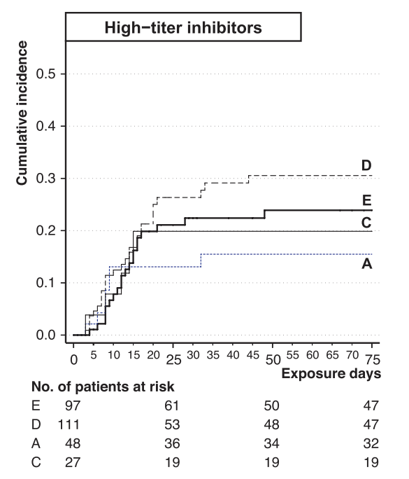
EUHASS – PTPs
Advate 0.11 (0.03 – 0.25)
Kogenate 0.17 (0.06 - 0.37)
OR = 1.54 (0.24 – 12)
Xi, PTP meta-analysis
Advate 0.10 (0.05 – 0.18)
Kogenate 0.26 (0.16 - 0.44)
Kogenate 0.11 (0.05 - 0.23)
OR = 2.6 (0.88 – 8.8)
Kogenate
Advate
Aledort BDD meta-analysis
Kogenate vs Advate
High titer
HR = 1.75 (0.05 – 65.5)
All inhibitors
HR, 2.43 (0.31–19.2)

Slide 31
Conclusion
Is the RODIN & Co party over?
The is no free lunch at the “risk of inhibitor study club”
Either we accept to adopt better methods for prospective assessment, or we have to adapt to live with some uncertainty

Slide 32
Thank you !!!
Download these slides at:
Hemophilia.mcmaster.ca
Join the WAPPS network at:
www.wapps-hemo.org

